Slide 1
We Have Work to Do! Concept #4: No One Has a Corner on All the Good Ideas
Presented by
Joan A. Zanders
Director of Financial Aid
Northern Virginia Community College
Chair, VASFAA FOCUS Committee

Slide 2
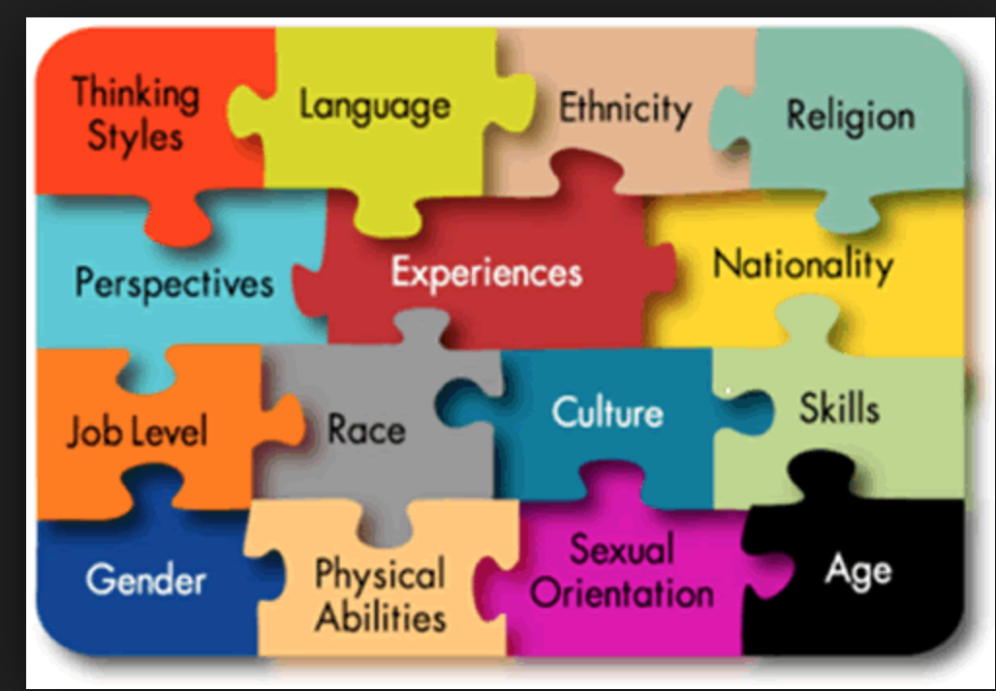
Have you ever wondered what you are missing…what you don’t know you don’t know?

Slide 3
Some years ago, I took a group of high school and college students to the Navajo Reservation in northeast Arizona. After a week of work, where our students were the teachers, we shared Sunday morning worship with our Navajo hosts.
Notes:
插入您所在国家/地区的地图。

Slide 4
During worship, which was in Navajo but strangely understandable, the little children were allowed to move around and play between the pulpit and the first row of the congregation. They were as quiet as church mice.
Notes:
插入您所在国家/地区的地图。

Slide 5
As I observed this unusual approach for me, I thought to myself, “Wow, we could learn something here! Children are not forced to sit in pews and act like little adults. They are allowed to be children…and maybe won’t grow up disliking the concept of ‘church’!”
Notes:
插入您所在国家/地区的地图。

Slide 6
Many cross-cultural trips with students to locations such as reservations, Appalachia, inner-island Jamaica, Uganda, the mountains of New Mexico, Japantown in San Francisco were made with the goal of giving…and we always came back having gained so much more than we ever could have given!
Notes:
插入您所在国家/地区的地图。

Slide 7
Each location and culture had something to teach us!
Notes:
插入您所在国家/地区的地图。

Slide 8
What if we looked at each culture, religion, ethnicity…individual!!…as though they had something to teach us? As though we needed something from that person in order to complete the puzzle?
Notes:
插入您所在国家/地区的地图。

Slide 9
Try looking at other staff members that way—from the college president to the janitor! We can learn from each one of them, no matter their education or background.
Notes:
插入您所在国家/地区的地图。

Slide 10
In the past two years, NOVA Financial Aid has begun developing a strengths-based staff, working from Gallup’s Strength Finder tool to encourage each staff member to utilize his/her talents.
Notes:
插入您所在国家/地区的地图。

Slide 11
People who know their talents and have the opportunity to use them at work:
Are six times as likely to be engaged in their jobs,
Are more than three times as likely to report having an excellent quality of life, and
Have 7.8% greater productivity.
Notes:
插入您所在国家/地区的地图。

Slide 12
The Five Guiding Principles of Strengths Finder:
Themes are neutral—no “right” or “wrong”.
Themes are not labels.
Lead with positive intent.
Differences are an advantage.
People need one another…
To complement one another’s strengths, and
To get the job done!
We each do some things better than the other person!
Notes:
插入您所在国家/地区的地图。

Slide 13
We each need to get over being perfect and believing that our own approach is superior! Just because you are (or I am) the Director doesn’t mean you (or I) have all the answers. You and I need others to get the job done.
Notes:
插入您所在国家/地区的地图。

Slide 14
Real life is no different! Consider the world as a giant classroom, and learn from it! None of us has a corner on all the good ideas, no matter our education, our culture, our religion.
Notes:
插入您所在国家/地区的地图。

Slide 16
Thank You

